Slide 1

12. SETS

Slide 2
SESSION OVERVIEW:
DEFINITION
CREATION
CHANGE
REMOVE
SET OPERATIONS
METHODS & BUILT-IN FUNCTIONS
OPERATIONS

Slide 3
DEFINITION
A Set is Created by placing all the elements inside a Curly Braces { } separated by commas ,
A Set can have any number of elements even of Different Data Types.
It is an Unordered Collection of Items.
Every Element is Unique (no duplicates) and must be immutable (which cannot be changed).
The set is Mutable. We can Add or Remove items from it
But a Set cannot have a mutable Element like list, set, dictionary as its element.

Slide 4
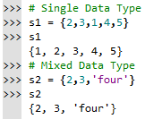






Slide 5
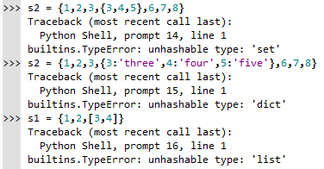

Slide 6
ACCESSING
Sets are Mutable. But since they are unordered, indexing have no meaning.
We cannot access or change an element of set using indexing or slicing. Set does not support it.

Slide 7
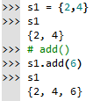

ADDING ELEMENTS
add() – to add 1 item
update() – to add more than 1 item

Slide 8
DELETION
del – to delete the Set itself
remove() – to delete using the value
pop() – to delete & returns the value
clear() – to delete all the items but not the list itself
discard() – same as remove(). But there is a difference.

Slide 9
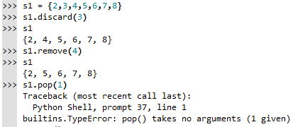
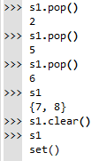
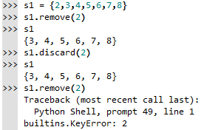

Slide 10
BUILT-IN FUNCTIONS
all()
any()
enumerate()
len()
max()
min()
sum()
sorted()

Slide 11
SET OPERATIONS
Repetition & Concatenation
Membership Test
Iteration

Slide 12
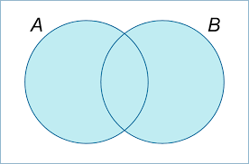


UNION

Slide 13
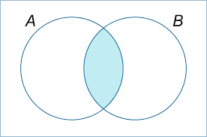

INTERSECTION

Slide 14
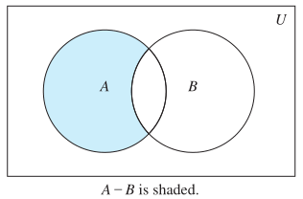

DIFFERENCE

Slide 15
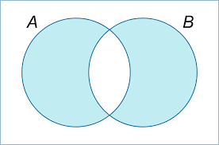

SYMMETRIC DIFFERENCE

Slide 16

CODING IS FUN ! THANK YOU !!

